Slide 1
RFC (894) Ethernet
-by Keshav Saraf
CS20b1062

Slide 2
What does RFC 894 Specifies?
Standard method of encapsulating Internet Protocol (IP) datagrams on an Ethernet.
Standard protocol for the ARPA-Internet community.

Slide 3
What is IP Datagram Encapsulation?
Data is passed to IP mainly through either TCP or UDP.
Data contains message and respective Headers.
Encapsulated into the body of an IP message, usually called an IP datagram or IP packet.

Slide 4
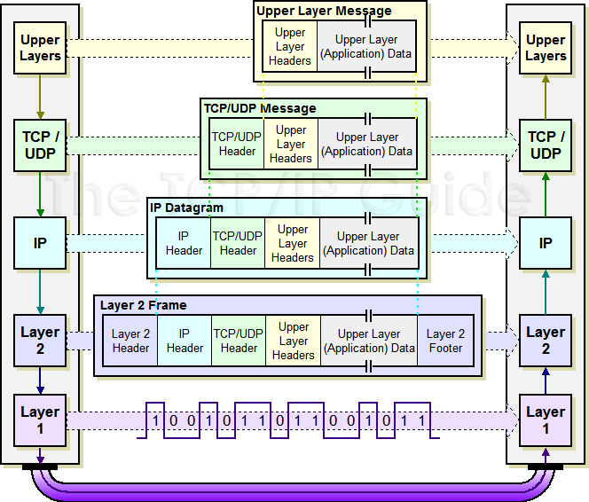
IP datagram Encapsulation

Slide 5
What is Ethernet?
Communication protocol that connects numerous devices to LAN (Local Area Network) or WAN (Wide Area Network).
Switches, printers, and computers exchange data uninterruptedly.
Wired connection that connects devices using ethernet switches and hubs.
Works with a hierarchical setup, including a gateway, router, ethernet port, switch, hub, and servers.

Slide 6
History of Ethernet
1973, Robert Metcalfe was on a mission to create a fast, secure, and cost-effective alternative for connectivity.
(In Past)Ethernet was not as fast and efficient as it is currently.
Businesses used because affordable and secure than others.
Complies with IEEE standards.
(Today) CAT5e or CAT6 ethernet cable, and enjoy a data transfer speed of up to 10 Gbps.

Slide 7
Why Ethernet?
Faster, securer, and more reliable when compared to Wi-Fi.
Uses CSMA/CD
Various Types of Ethernet Networks:
Fast Ethernet(10BaseT cabling, Max 100Mbps).
Gigabit Ethernet(CAT5e or fiber optic ,Max 1Gbps).
10 Gigabit Ethernet(CAT6e cable.Max 10Gbps).
Hybrid model(Connect Fast Ethernet and Gigabit Ethernet)
PAM3 (Pulse Amplitude Modulation) reduce the signal-to-noise ratio.
Sensitive data stays safe from DDoS(fake traffic) attacks and other cybercrimes.
Cost-Effective(Than Wif over Range).

Slide 8
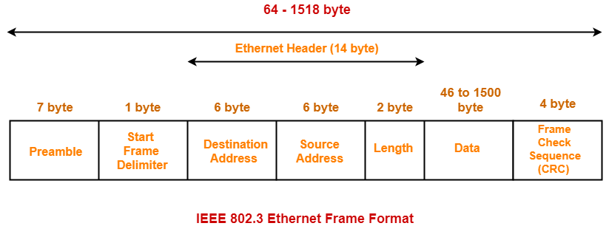
Ethernet (IEEE 802.3) Frame Format

Slide 9
Components of Ethernet Frame
Preamble ->pattern of alternative 0’s and 1’s allow bit synchronization.
Start of frame delimiter (SFD) –>1-Byte field which is always set to 10101011.
Destination Address -> 6-Byte field MAC address.
Source Address -> 6-Byte field MAC address.
Length -> 2-Byte field, length of entire Ethernet frame.Length value between 0 to 65534, but length cannot be larger than 1500 Bytes because of some own limitations of Ethernet.
Data -> This is the place where actual data is inserted, also known as Payload.Size 46B(Collision Detection) to 1500B.
Cyclic Redundancy Check (CRC) –>4 Byte field.Destination Address, Source Address, Length, and Data field verification.

Slide 10
Addressing Mapping
The mapping of 32-bit Internet addresses to 48-bit Ethernet addresses can be done several ways. A static table could be used, or a dynamic discovery procedure could be used.
Static Table->Each host could be provided with a table of all other hosts on the local network with both their Ethernet and Internet addresses.
Dynamic Discovery ->Mappings between 32-bit Internet addresses and 48-bit Ethernet addresses could be accomplished through the Address Resolution Protocol (ARP).
Broadcast Address ->Should be mapped to the broadcast Ethernet address (of all binary ones, FF-FF-FF-FF-FF-FF hex).

Slide 11
ARP
The acronym ARP stands for Address Resolution Protocol which is one of the most important protocols of the Network layer in the OSI model.
Finds Media Access Control (MAC) address, of a host from its known IP address.
An ARP request is a broadcast, and an ARP response is a Unicast.

Slide 12
How ARP Works?
ARP Cache->Stored MAC address in a table for future reference.
ARP Cache Timeout-> Time for which the MAC address in the ARP cache can reside.
ARP request: This is nothing but broadcasting a packet over the network to validate whether we came across the destination MAC address or not.
The physical address of the sender.
The IP address of the sender.
The physical address of the receiver is FF:FF:FF:FF:FF:FF or 1’s.
The IP address of the receiver
ARP response/reply: It is the MAC address response that the source receives from the destination which aids in further communication of the data.

Slide 13
References
http://www.tcpipguide.com/free/t_IPDatagramEncapsulation.htm
http://groups.di.unipi.it/~augusto/libro/rfc-pdf/rfc894.pdf
https://fasttrackcomm.net/what-is-ethernet/
https://www.geeksforgeeks.org/ethernet-frame-format/
https://www.gatevidyalay.com/ethernet-ethernet-frame-format/
https://www.geeksforgeeks.org/how-address-resolution-protocol-arp-works/

Slide 14
Thank you

